Slide 1

Chapter 4
Introduction to Django Admin

Slide 2

Objectives
How to integrate your Django app with the admin app and you'll also look at the behavior of ForeignKeys in the admin app.
How you can customize the admin app according to a unique set of preferences by sub-classing the AdminSite and ModelAdmin classes.

Slide 3
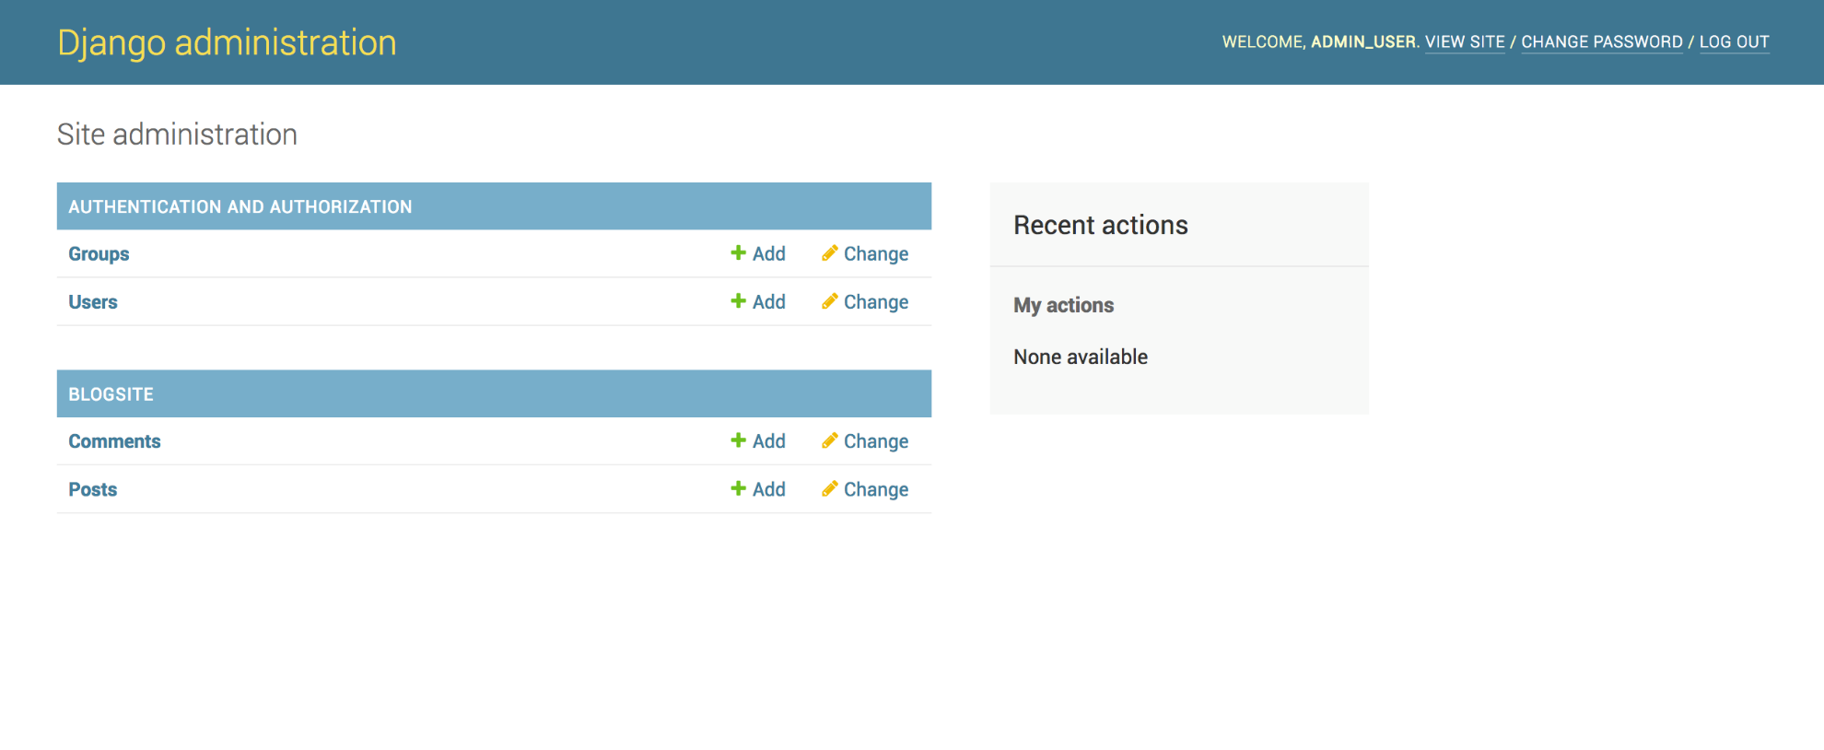
Introduction

Slide 4
Introduction
Django admin is actually written as a Django app.
It offers an intuitively rendered web interface to give administrative access to the model data.
The admin interface is designed to be used by the administrators of the website

Slide 5
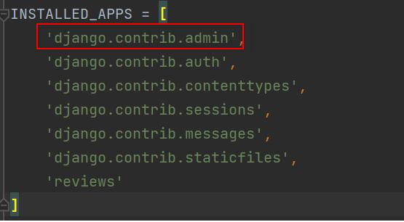
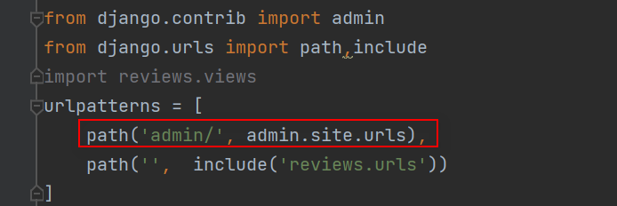
Introduction
Admin app in your Bookr project

Slide 6

Creating a Superuser Account
We will use the createsuperuser subcommand by entering the following command in the command line (you will need to write python instead of python3 if you're using Windows):

Slide 7
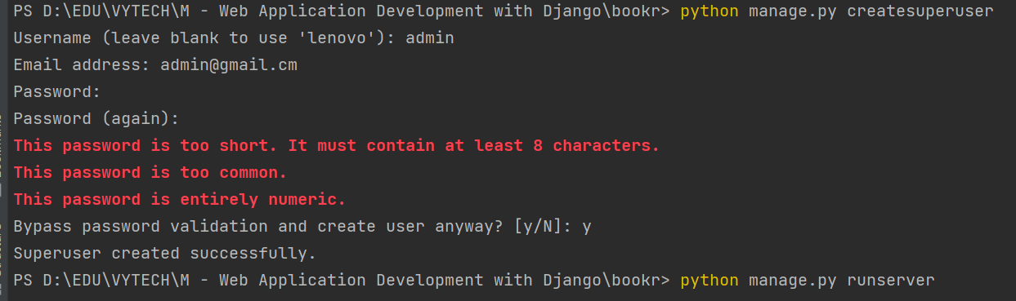
Exercise
Exercise 4.01: Creating a Superuser Account

Slide 8
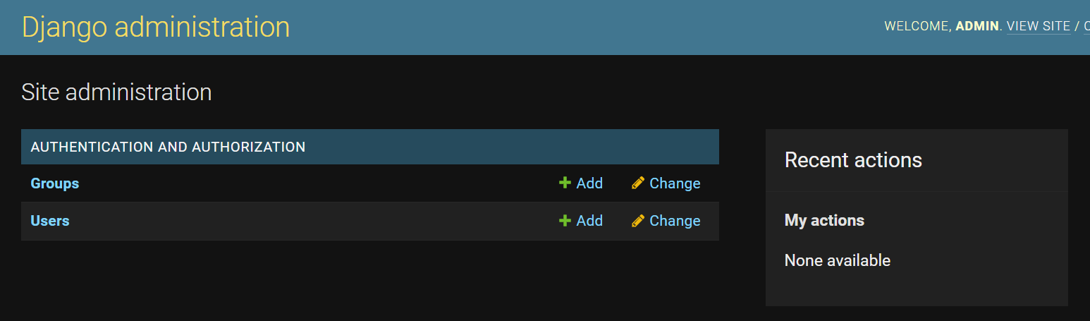
CRUD Operations Using the Django Admin App
The Django administration window

Slide 9
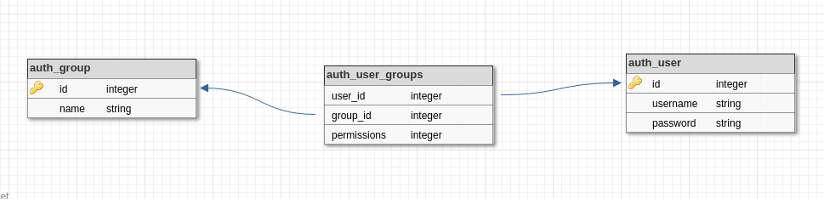
Users and Groups
ERD user and groups in django admin

Slide 10
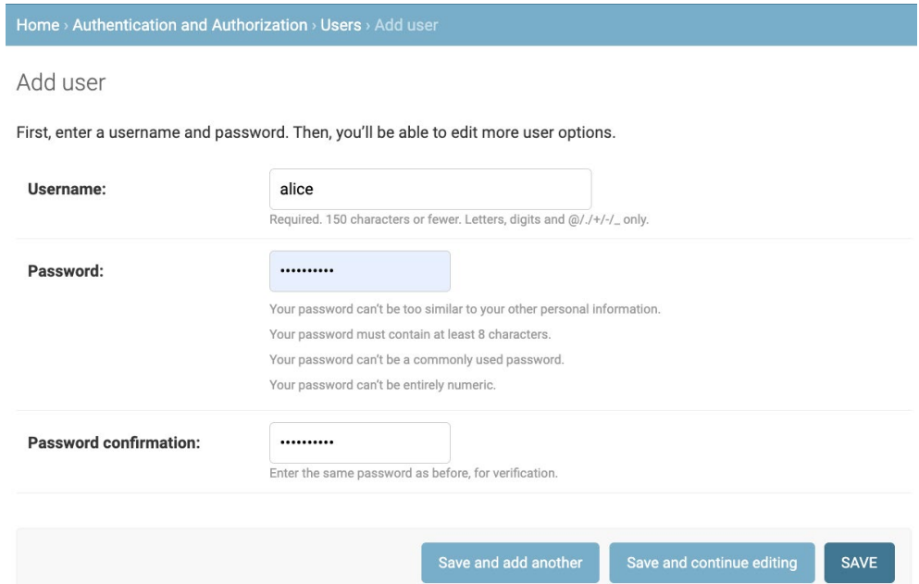
Create
To Create a user, we need only click the
+ Add link next to Users.

Slide 11
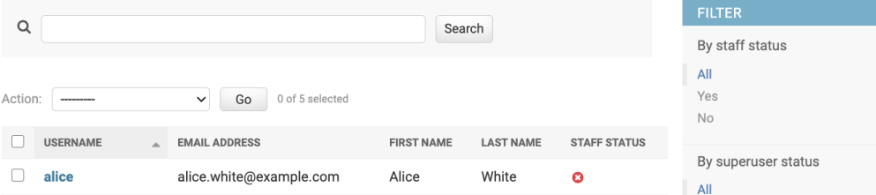
Retrieve
Retrieve functionality can come in handy. After we have clicked the SAVE button on the Add user page (refer to Figure 4.4), we are taken to the Select user to change list page.

Slide 12
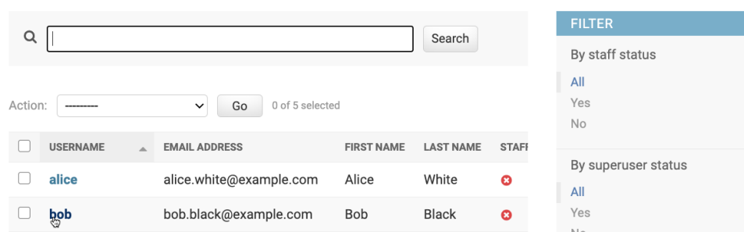
Update
Clicking the username link in the Select user to change list.

Slide 13
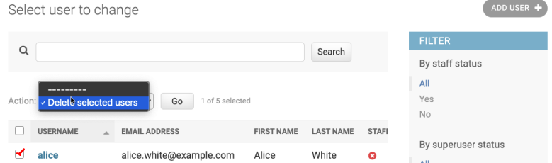
Delete
Select user to change list page and choose the Delete selected users option from the Action dropdown. Then hit the Go button.

Slide 14
Users and Groups
Django's authentication model consists of users, groups, and permissions.
Users can belong to many groups and this is a way of categorizing users.
It also streamlines the implementation of permissions by allowing permissions to be assigned to collections of users as well as individuals.

Slide 15
Users and Groups
ERD user and groups in django admin

Slide 16
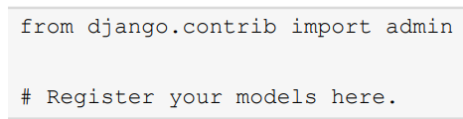
Registering the Reviews Model
To make the admin app aware of the models, we need to explicitly register them with the admin app.
reviews/admin.py file

Slide 17
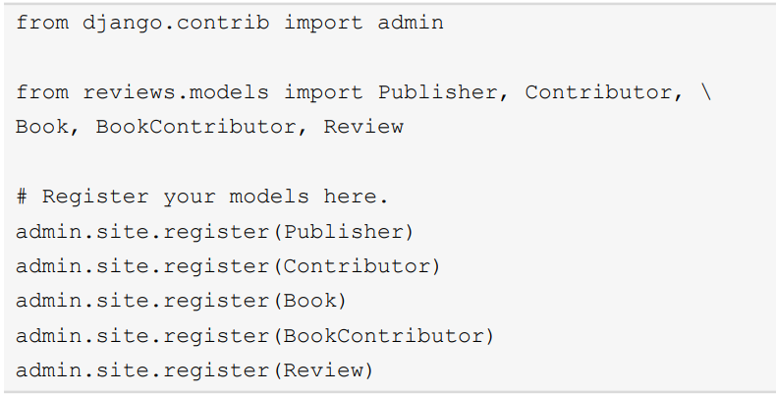
Registering the Reviews Model
reviews/ admin.py

Slide 18
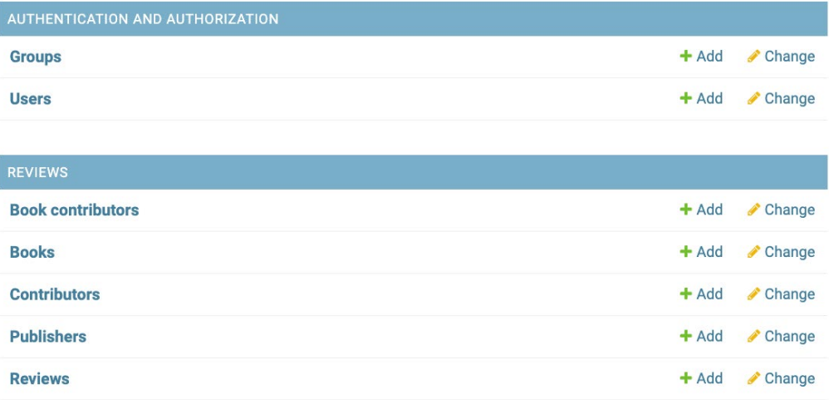
Registering the Reviews Model
Appearance of the admin page after the reviews model has been imported.

Slide 19
Customizing the Admin Interface

Slide 20
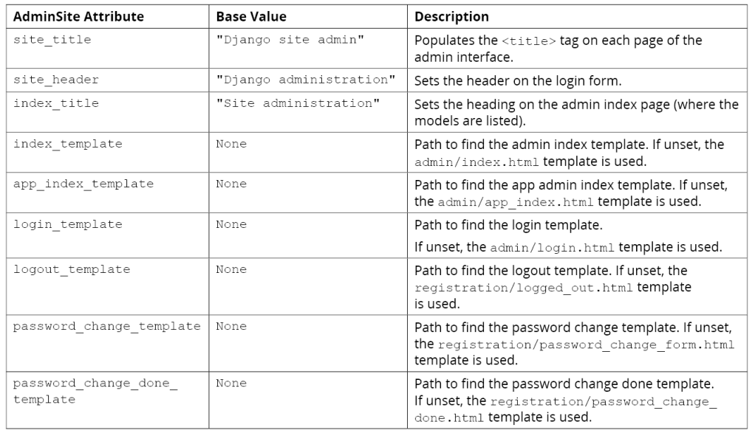
Site-Wide Django Admin Customizations
Simplest customizations to improve the usability of your app's admin interface

Slide 21
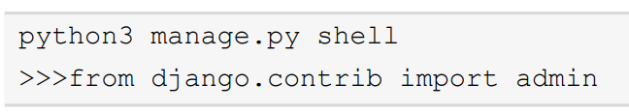
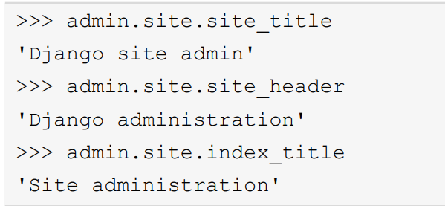
Examining the AdminSite object from the Python Shell

Slide 22
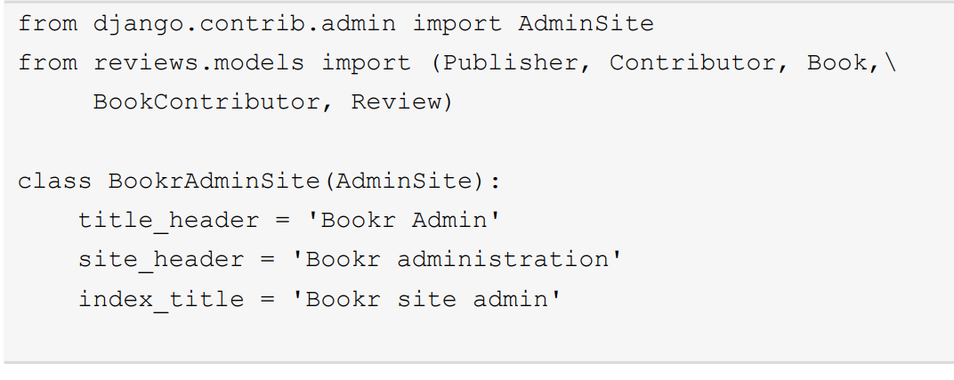
Subclassing AdminSite

Slide 23
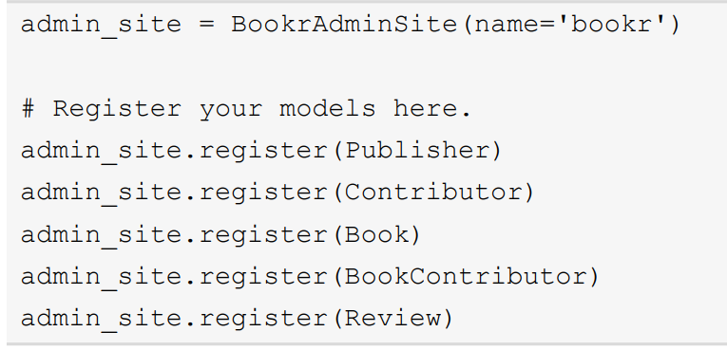
Subclassing AdminSite

Slide 24
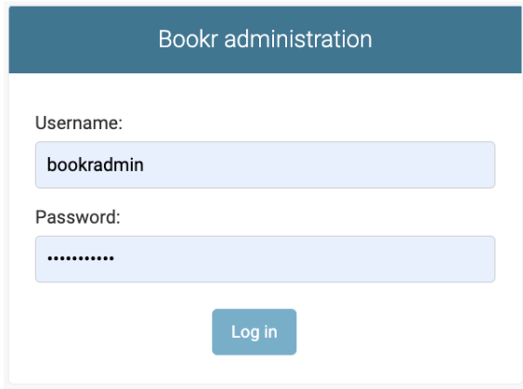
Subclassing AdminSite

Slide 25
The Filter
Once the admin interface needs to deal with a significant number of records, it is convenient to narrow down the results that appear on change list pages.

Slide 26

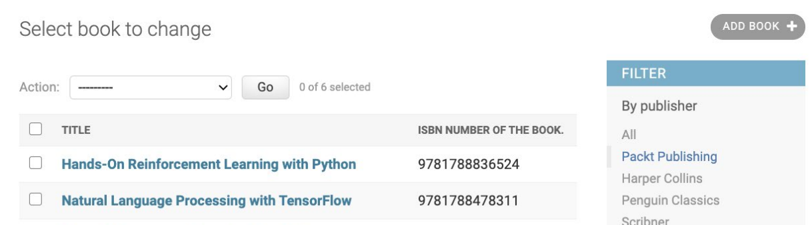
The Filter
We can specify our change list filter in reviews/admin.py in the BookAdmin class:

Slide 27
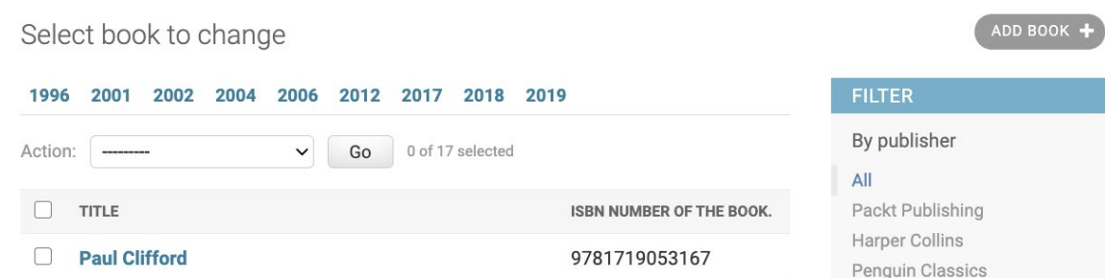
The Search Bar
This brings us to the remaining piece of functionality that we wanted to implement – the search bar.

Slide 28
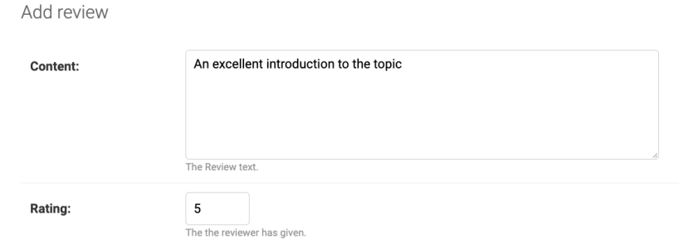
Excluding and Grouping Fields
There are occasions when it is appropriate to restrict the visibility of some of the fields in the model in the admin interface.

Slide 29
Summary
-In this chapter, we saw how to create superusers through the Django command line and how to use them to access the admin app.
- After a brief tour of the admin app's basic functionality, we examined how to register our models with it to produce a CRUD interface for our data

